Slide 1

Introduction to Data Science/Machine Learning
University of Wisconsin Milwaukee
Fall 2025
Sammie Omranian

Slide 2

Girls Who Code – Week 4
Review: Lists & Dictionaries → Intro to DataFrames

Slide 3
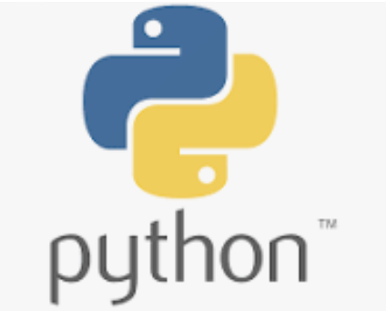
Agenda
Today’s Plan:
Review –Lists, Dictionaries
DataFrames - From Dictionary to DataFrame
Hands-On Activity – worksheet 4 and 5
Reflection & Wrap-Up

Slide 4

Review - Lists
- A list is a collection of items, in order.
- Written with square brackets: [ ]
Example:
Lists:
Store multiple values
Items can be numbers, strings, or mixed

Slide 5
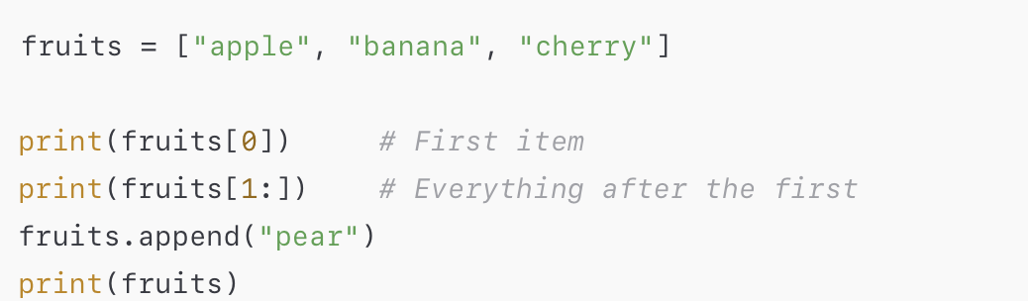
Practice: Lists in Action 🍎🍌🍒
👉 Try it yourself in Google Colab (or your coding notebook):
🧠 Questions:
What does fruits[0] show?
What happens when we add "pear"?
Can you make your own list of 3 favorite snacks?

Slide 6
Quick Review: Dictionaries
A dictionary stores key → value pairs key, value
Written with curly braces: { }
Example:
✅ Keys = labels
✅ Values = data linked to each key

Slide 7
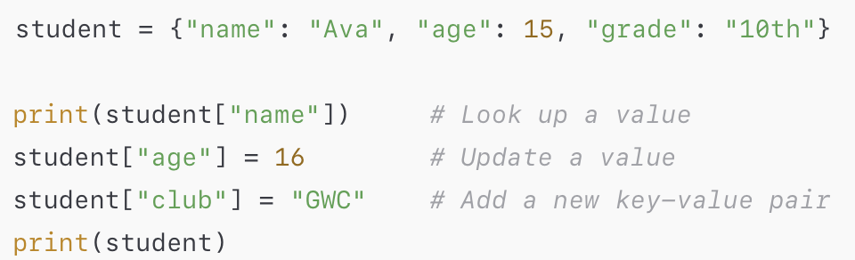
Practice: Dictionaries in Action 📖
👉 Try it yourself in Google Colab (or your coding notebook):
🧠 Questions:
What does student["name"] show?
What changed when we updated "age"?
Can you add your own key–value pair (like "favorite_color") to the dictionary?

Slide 8
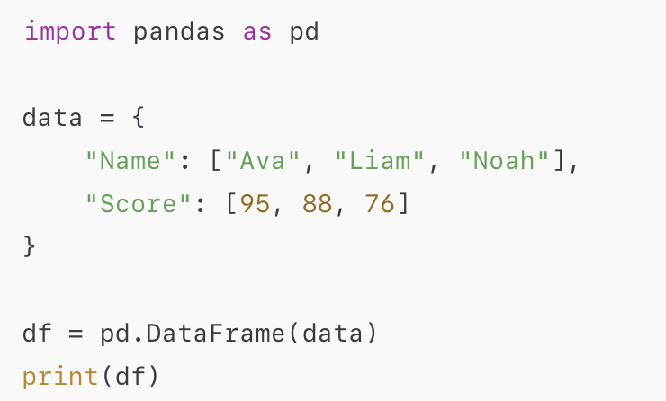
From Dictionary to DataFrame
Real datasets look like tables (rows & columns).
In Python, we use pandas DataFrame for this.
➡ Output looks like a table! Try it!

Slide 9
Why DataFrames?
Easier to work with large datasets
Columns = variables (Name, Score, Age)
Rows = observations (each student, each passenger, each city)
Can clean, analyze, and visualize!

Slide 10
Explore a DataFrame
Commands to try:
df.head() → first rows
df.info() → summary of columns
df.describe() → quick statistics
🧠 Question: “What does df["Name"] show us?”

Slide 11


Edit a DataFrame
- Add a new column:
- Edit a value:
🧠 Question: “What changed in the table?”

Slide 12

Google Colab – Our Coding Hub Where we’ll write, run, and share all our Python code

